Slide 1


BMS INSTITUTE OF TECHNOLOGY AND MANAGEMENT
DEPARTMENT OF ELECTRONICS AND COMMUNICATION
Avalahalli, Yelahanka, Bangalore - 560064
Technical Seminar on ‘Audio Spotlight’
RAJESHWAR N S
1BY13EC059

Slide 2

Is it Possible to confine a sound to a small area?

Slide 3
Overview
Introduction
Basic Idea
History
Technology Overview
Working Principle
Block Diagram
Advantages
Applications
References

Slide 4
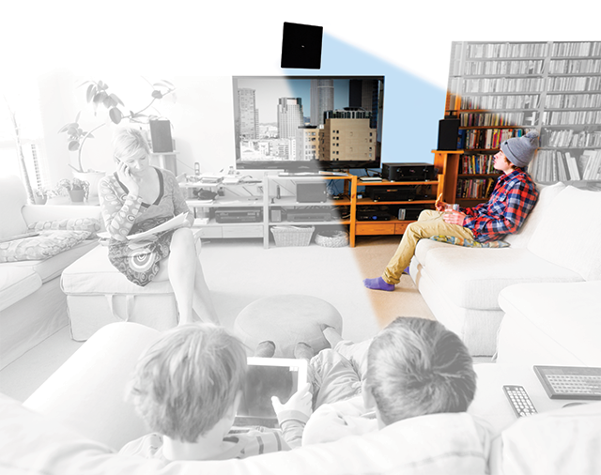
What’s Audio Spotlight ?
The Audio Spotlight technology creates a tight, narrow beam of sound that can be controlled with the same precision as light. Aim the speaker at your desired listening area to keep sound focused speciﬁcally to your listeners and quiet everywhere else.

Slide 5
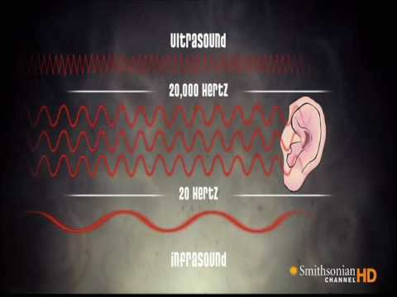
Basic Idea
Uses Ultrasonic energy to create extensively narrow beams of sound that behaves like a spotlight.
Ultrasonic sound has very small wavelength in millimeter range and lies beyond the threshold of human hearing.

Slide 6
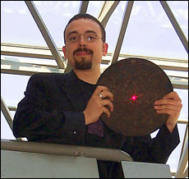
History
Originally developed by US and Soviet Navy for underwater Sonar in mid 60’s
Dr. F Joseph Pompei of MIT published a paper in 1998 that described a working device which reduces audible distortion compared to a traditional loudspeaker.
Commercially made available in 2000 by the company ‘Holosonics’
Disney was amongst the first major corporations to adopt it for use at the Epcot Center.

Slide 7
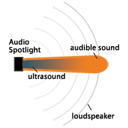
Technology Overview
To produce highly focused audio signal use loud speakers with large aperture size.
Parametric array employs non-linearity of air to create audible by products from inaudible ultrasonic sound resulting in directive and beam like sound.
As the beam moves through the air gradual distortion takes place in a predictable way.This gives rise to audible components that can be accurately predicted and precisely controlled.

Slide 8
Working Principle
Frequency modulated signal travel through air, non-linearity property of air comes into action which slightly changes the sound wave.
Due to change in a sound wave (ultrasonic), new sounds are formed within the wave.
New sound signal corresponds to the original information signal in the range 20 HZ-20 KHZ.
Inherent nonlinearity of air works as a demodulator & thus demodulated sound impinge on our eardrums.

Slide 9
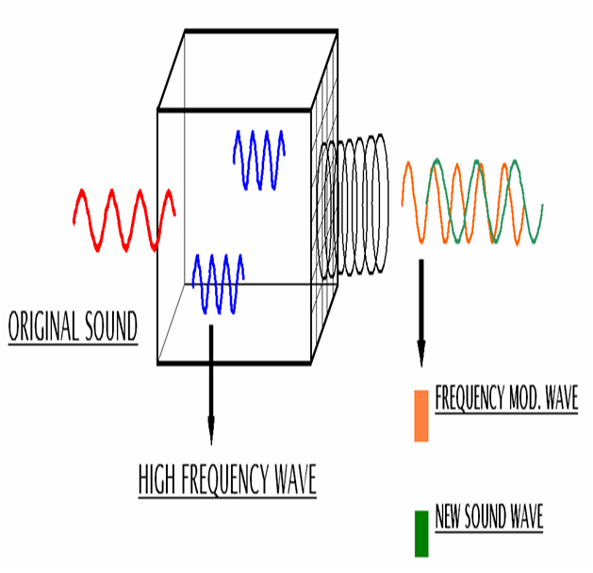
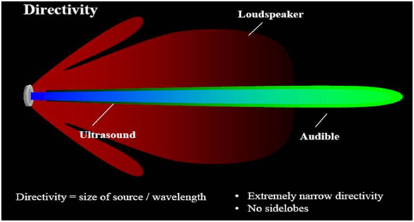

Slide 10
Components
Power supply
Frequency oscillator
Modulator
Audio Signal Processor
Microcontroller
Ultrasonic Amplifier
Transducer

Slide 11
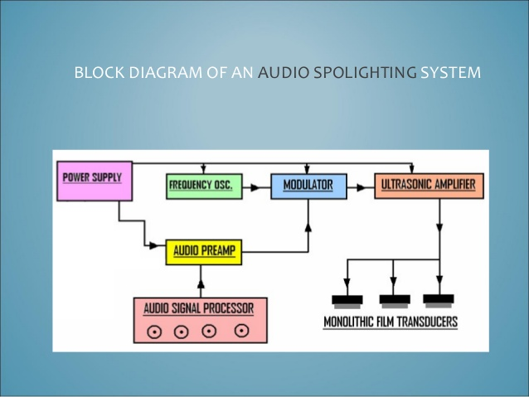
Block Diagram

Slide 12
Modes of Listening
Direct Mode:
Direct mode requires a clear line of approach from the sound system unit to the point where the listener can hear the audio.To restrict the audio in a specific area this method is appropriate.
Projected or Virtual Mode:
This mode requires an unbroken line of approach from the emitter of audio spotlighting system,so the emitter is pointed at the spot where the is to be heard.For this mode of operation the sound beam from emitter is made to reflect from a reflecting surface such a wall surface or a diffuser. A virtual sound source creates an illusion of sound source that emanates from a surface or direction where no physical loudspeaker is present.

Slide 13
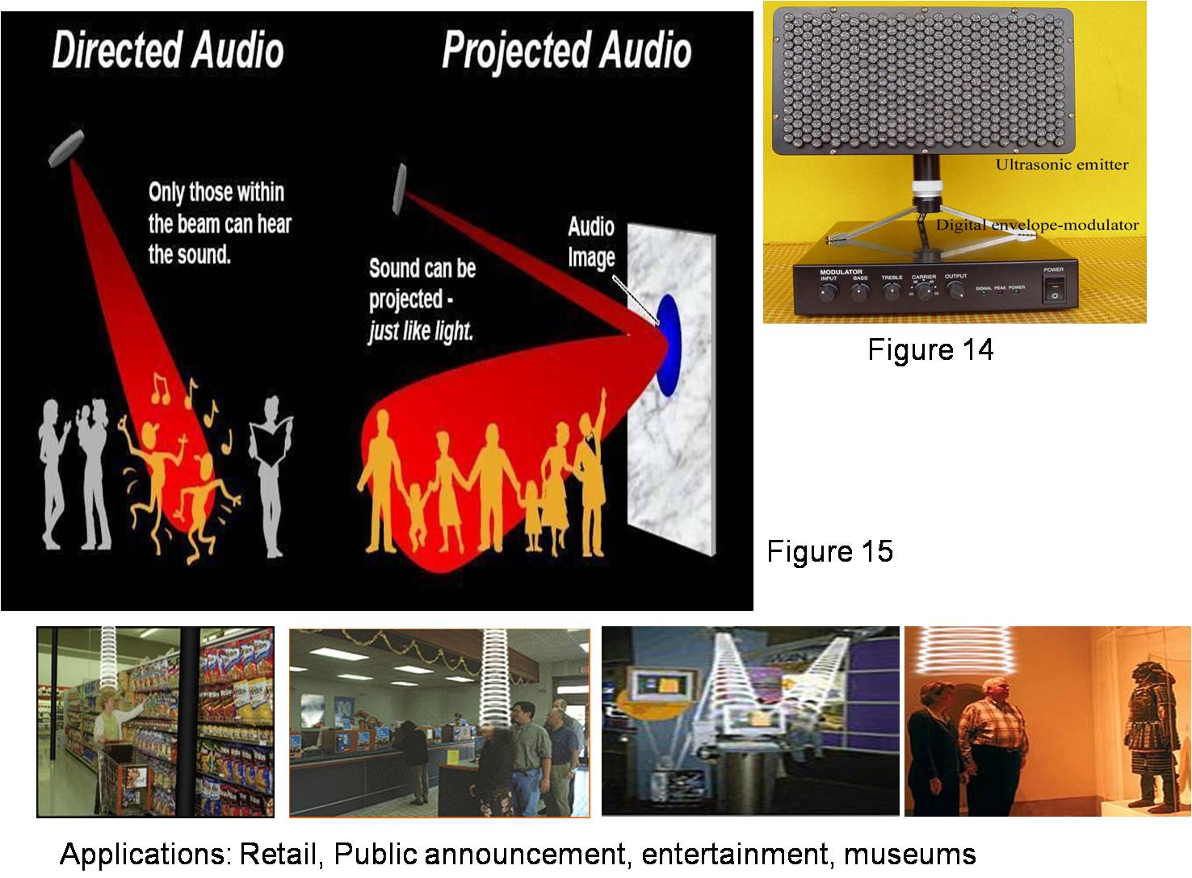

Slide 14
Transducer Technology
To cover a certain frequency range.
To have a certain dispersion pattern which In order to make this technology work, ultrasonic energy must be emitted into the air. Electrical signals are converted into these acoustic signals by means of an ultrasonic transducer. Acoustic transducers or emitters can be designed sharp.
A bandwidth from around 20 KHz to infinity.
A sharp dispersion pattern that gives a collimated beam of ultrasound.
Unlimited output capabilities.

Slide 15
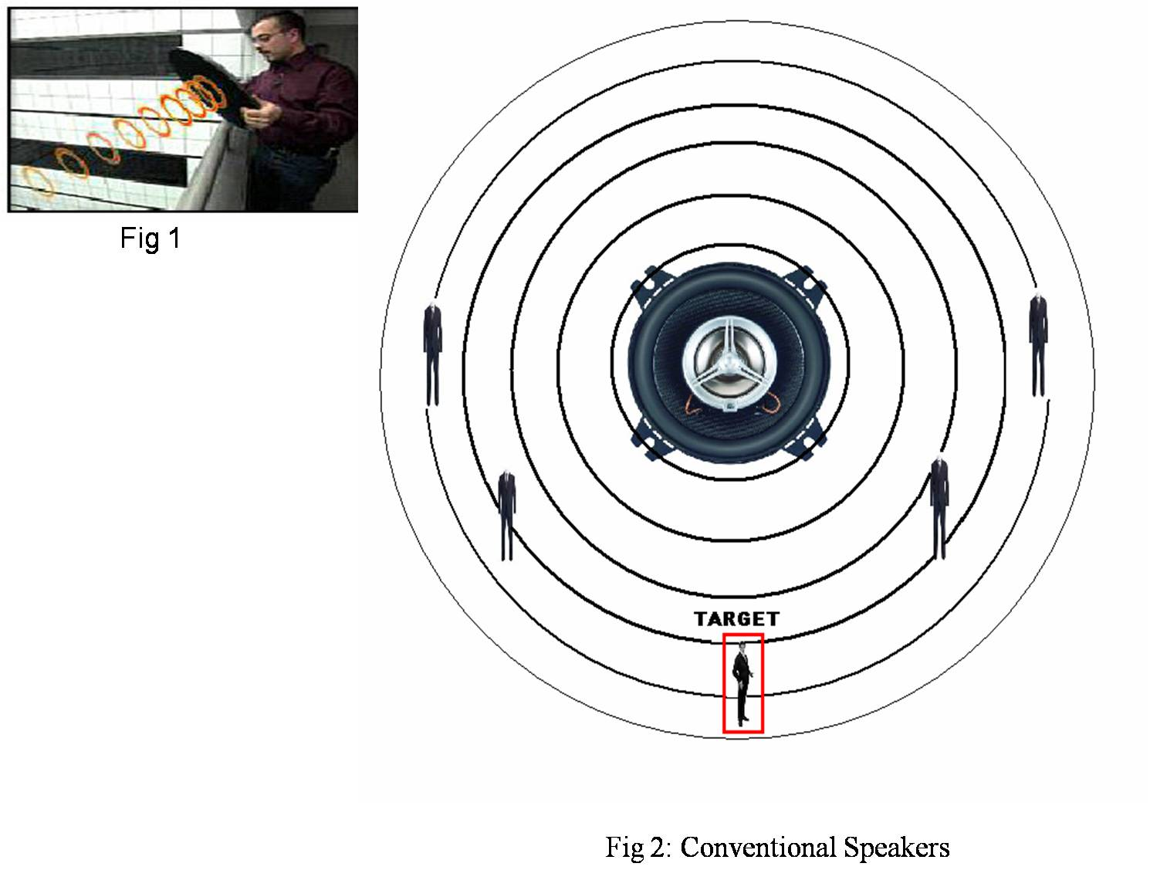
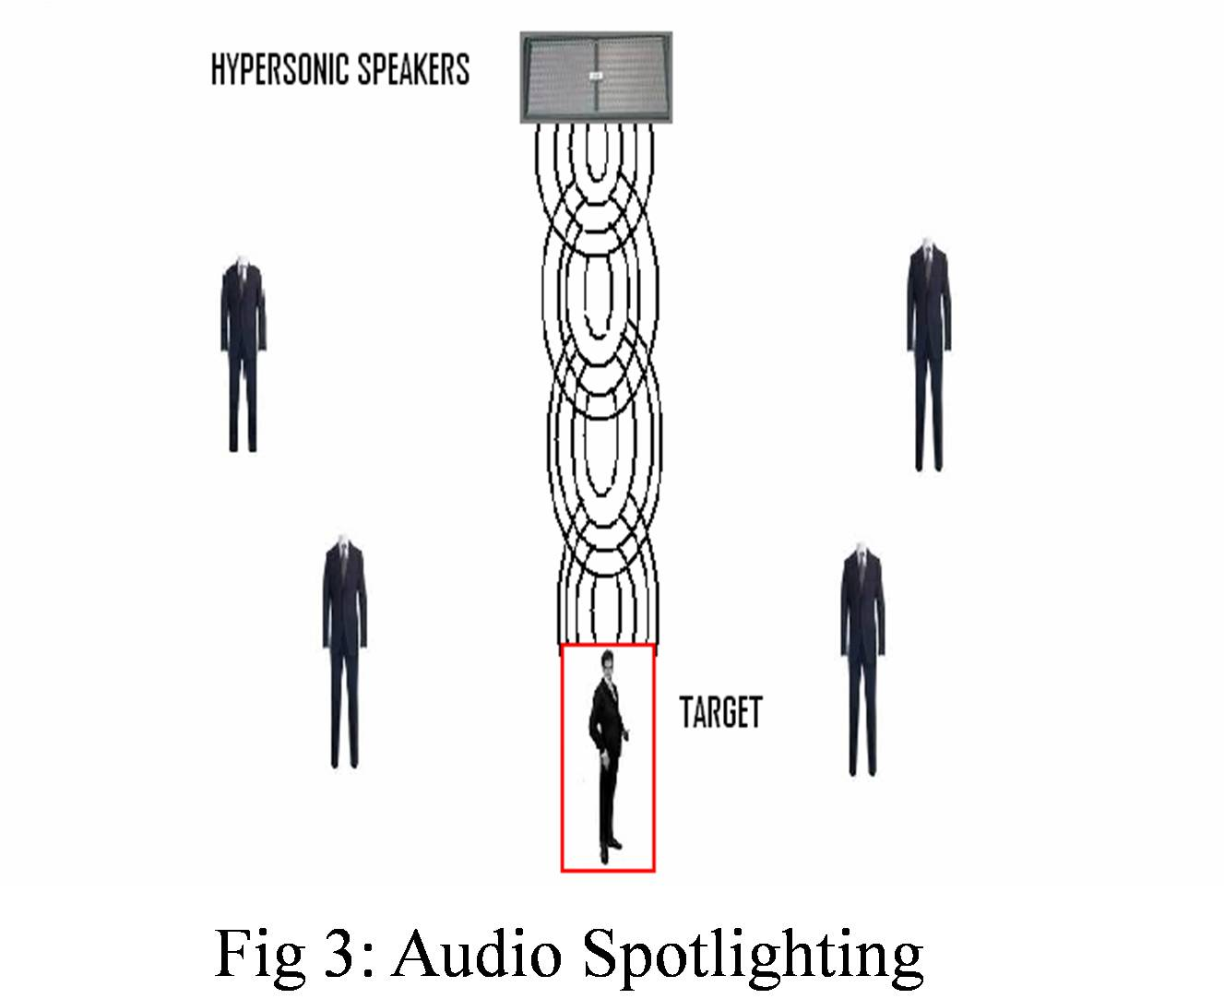
Conventional Speakers Spotlight Speakers

Slide 16
Advantages
Can focus sound only at the place you want.
Ultrasonic emitter device are thin and flat and do not require a mounting cabinet.
The focused or directed sound travels much faster in a straight line than conventional loudspeaker.
Dispersion can be controlled very narrow or wider to cover more listening area.
Can reduce or eliminate the feedback from microphone.
Highly cost effective as the maintenance required is less as compared to conventional loud speakers and have longer life span.
Requires only same power as required for regular speakers.
There is no lag in reproducing the sound.

Slide 17


Applications
Automobiles
Beam alert signal can be directly propagated from an announcement device in the dashboard to the driver ..
Retail Sales
Provide targeted advertising directly at the point of purchase.

Slide 18
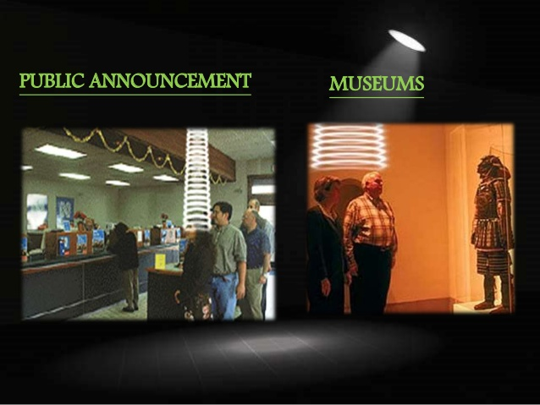
Safety officials: Portable audio spotlighting device for communication with a specific person in a crowd of people.
Public announcement: Highly focused announcement in noisy environment such as subways,airport,traffic intersections etc..
Emergency rescue: Rescue can communicate with endangered people far from reach.
Entertainment system: In home theatre system tear speaker can be eliminated by the implementation of audio spotlighting and the properties of sound can be improved.
Museums:In museums audio spotlighting can be used to describe about a particular object to a person standing in front it ,so that the order person standing in front of another object will not be able to here the description

Slide 19

Thank you!

